Slide 1
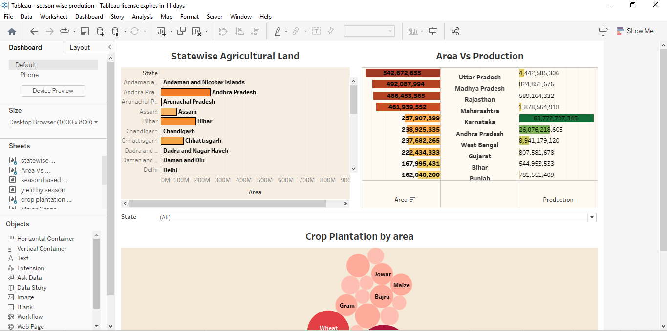
Dashboard 1

Slide 2
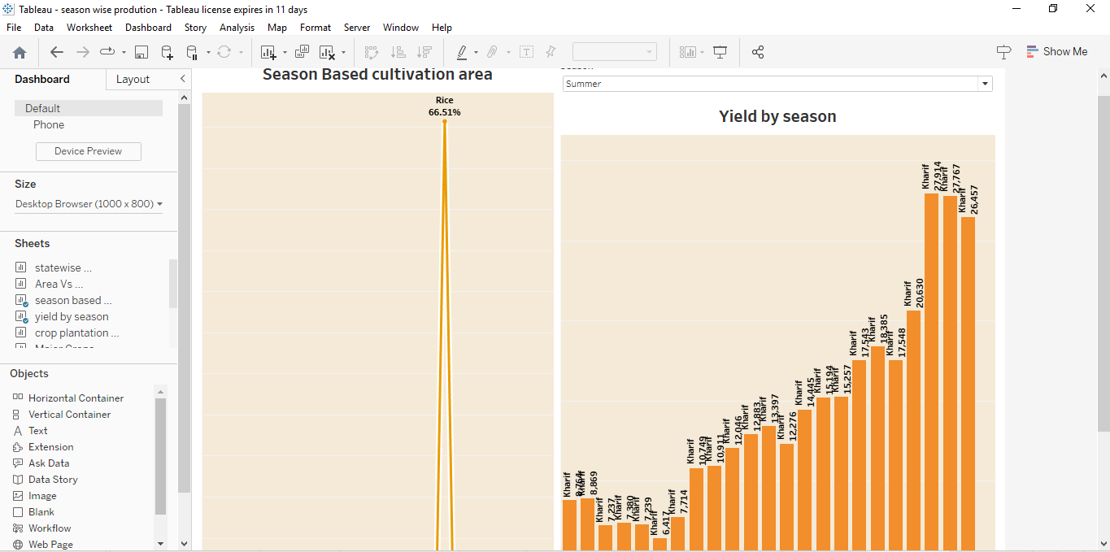
Dashboard 2

Slide 3
Dashboard 3

